Slide 1

Measuring the Centre of Data
Year 11 Essentials

Slide 2
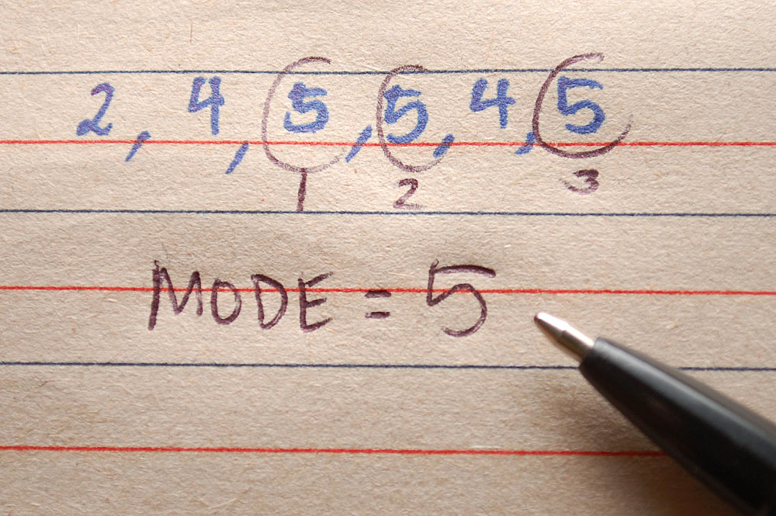
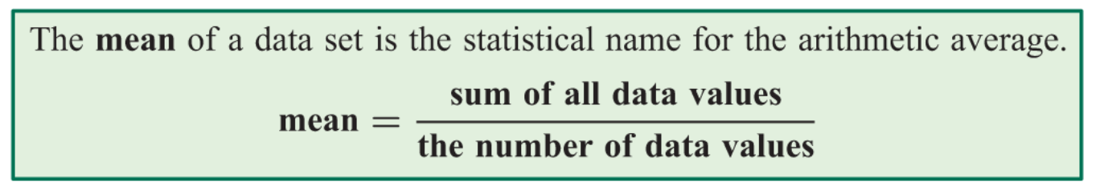
24
7
30
Measuring the Centre of Data
Date
EQ – How do we measure the centre of the data?
How can we better describe the data?
There are three statistics that are used to measure the centre of the data set:
Mode – Most Common
Mean – The Average
Median – The Middle
The mode is the most frequently occurring value in the data set.
What is the Mode?
What is the Mean?
What is the Median?

Slide 3
24
7
30
Measuring the Centre of Data
Date
EQ – How do we measure the centre of the data?
Use the following data set to demonstrate.
1, 3, 3, 6, 7, 8, 9
Mean =
Median =
Mode =
1, 2, 3, 4, 5, 6, 8, 9
Mean =
Median =
Mode =

Slide 4


Slide 5
Task – Complete Questions on Page 102

Slide 6
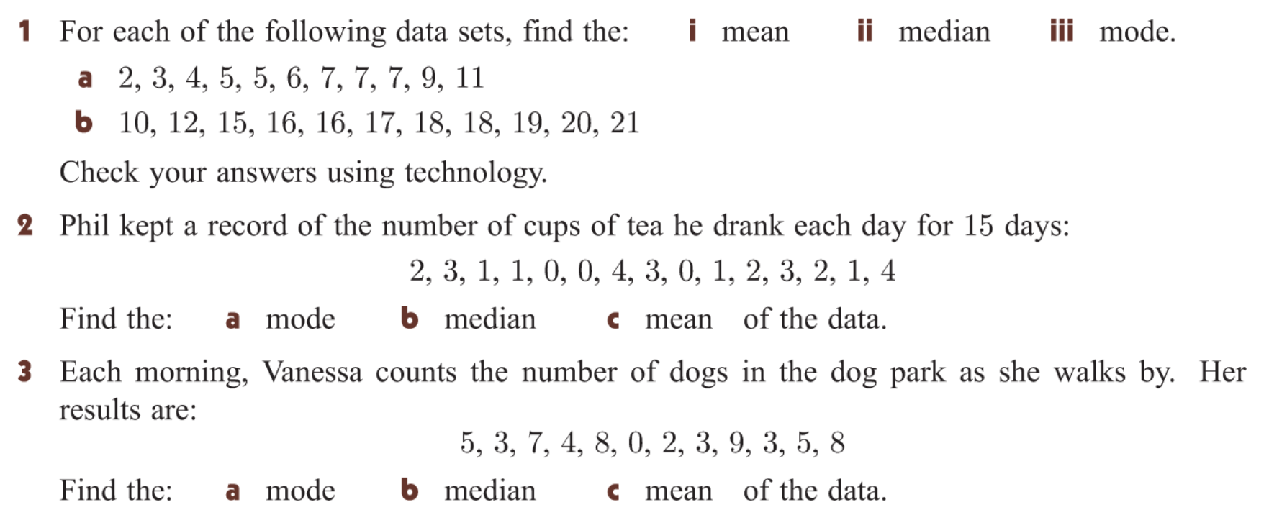
Additional task

Slide 7
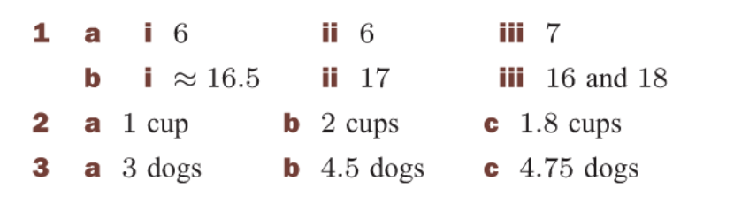

Slide 8
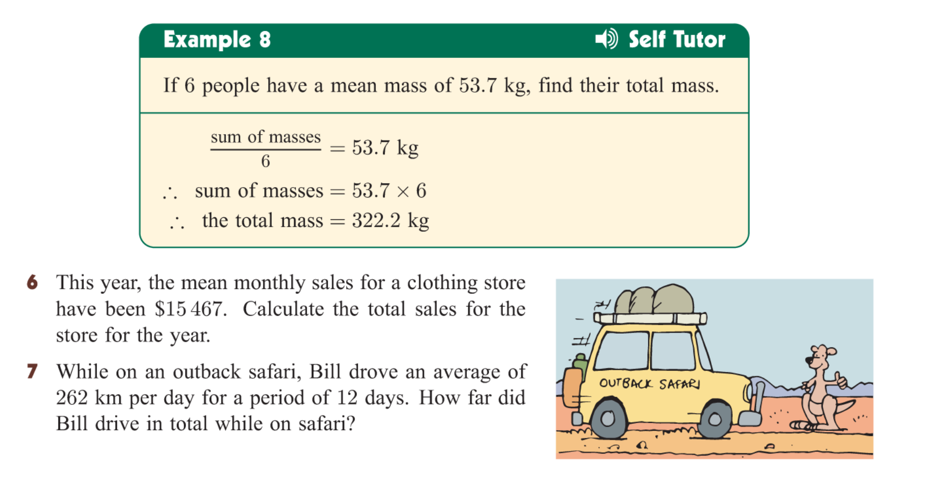

Slide 9


